Slide 1


NIE INSTITUTE OF TECHNOLOGY DEPARTMENT OF ELECTRICAL AND ELECTRONICS ENGINEERING
PROJECT WORK PHASE-2
(21EEMP67)
PRESENTATION ON
“AUTOMATIC IRRIGATION SYSTEM USING SOLAR TRACKING SYSTEM”
TEAM MEMBERS:
DHRUV KUMAR (4NN21EE010)
SNEHAL KUMAR SINGH (4NN20EE042)
SPOORTHI.R (4NN20EE043)
VINAYAK V KULKARNI (4NN21EE048)
UNDER THE GUIDANCE OF:
MR.SRINIVAS.S
ASSISTANT PROFESSOR
DEPT OF EEE
NIEIT, MYSURU
1
09/08/24

Slide 2
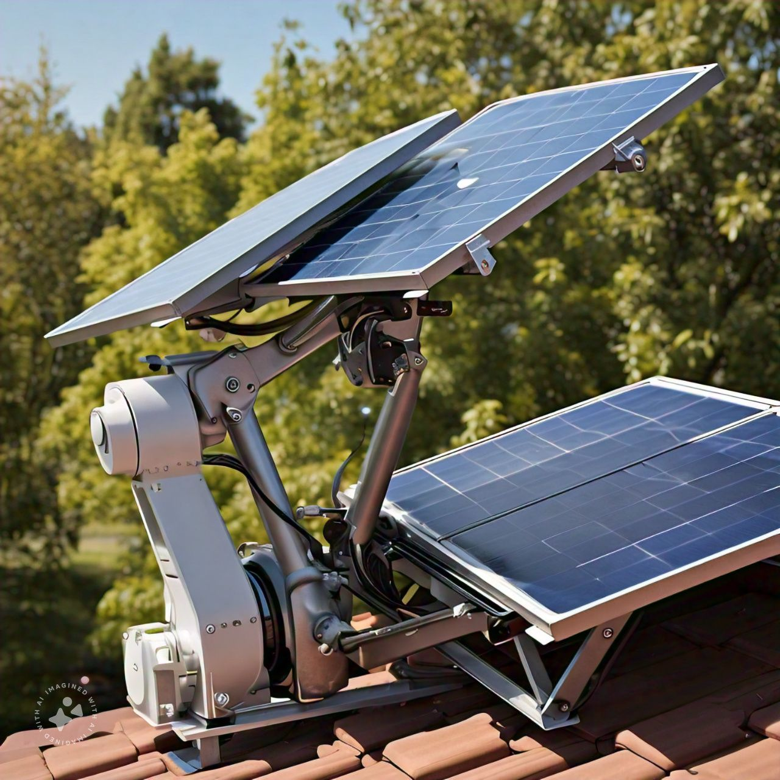
CONTENTS
INTRODUCTION
LITERATURE SURVEY
OBJECTIVES
SCOPE OF THE PROPOSED WORK
PROPOSED METHODOLOGY
COMPONENTS USED
CIRCUIT DIAGRAM
CONCLUSION
FUTURE SCOPE
REFERENCE
2

Slide 3
INTRODUCTION
Integration of Renewable Energy and Water Management:
Combines solar energy with efficient irrigation to optimize resource use.
Solar Tracking Mechanism:
Solar panels are equipped with tracking systems to follow the sun, maximizing energy capture.
Energy Harvesting:
The solar energy collected throughout the day powers the irrigation system.
Automated Irrigation:
Sensors monitor soil moisture levels to automate the watering process.
Soil Moisture Control:
Irrigation activates when soil moisture drops below a set threshold, ensuring crops receive the necessary water.
Benefits:
Reduced Dependence on Non-Renewable Energy: Utilizes solar power instead of conventional energy sources.
Precise Water Usage: Delivers the exact amount of water needed, preventing wastage.
Enhanced Crop Yields: Maintains optimal moisture levels, promoting healthy plant growth.
Sustainability and Accessibility:
Suitable for remote or off-grid areas, providing a sustainable and cost-effective agricultural solution.
3

Slide 4
LITERATURE SURVEY
In early years, electricity is available only to a specific section of affluent society. Th advancement in technology over time encouraged meeting the demands of common people in all parts of the world. The history of electricity meter is well connected involving research from past. The general usage of electricity in the early 1870’s is only confined to telegraphs and arc lamps. With the invention of the electric bulb by Thomas Elva Edison, the power energy market became widely opened to the public in year 1879. Eventually, the progressive development in metering technology leads in enlightening the year 1888.Eventually, the progressive development in metering technology leads in enlightening the lives of many common people
PROBLEM DEFINITION
There is scarcity of water and electricity for farmers. There was no proper methodology for the proper utilization of available resources. And farmers also need to water the crops manually depending on the moisture content of the soil. This project helps farmers to utilise the solar energy which is freely available and automatically provide water to the crops when required by sensing the moisture content in the soil there by utilising the water to a great extent. But there are chances of failure of automation system due to environmental conditions. Hence along with automatic system manual operation also should be there. Manual system will supply the water if any short circuit occurs in automation system. Irrigation system should not disturb to get target productivity so, by switching the manual switch we can irrigate the field. Also by installing manual switch we can use pump to supply water for other purpose. If the battery is down and also solar system is not charging the battery, then system will not work, for smooth working of system adopter or main supply is needed. Hence multiple sources for power supply are proposed.
4

Slide 5
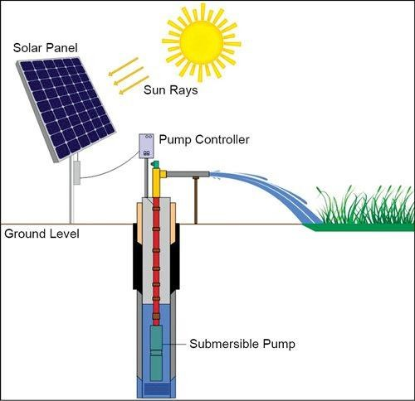
OBJECTIVES
Maximize Solar Energy Utilization: Develop a solar tracker system that optimizes the orientation of solar panels to capture the maximum sunlight throughout the day, thereby enhancing energy efficiency.
Automate Irrigation Processes: Create an automated irrigation system powered by solar energy, capable of efficiently drawing and distributing water to agricultural fields using a water pump and sprinklers.
Optimize Water Usage with Soil Sensors: Integrate soil moisture sensors to monitor and maintain optimal soil moisture levels, activating the irrigation system only when necessary to conserve water and ensure precise irrigation.
Enhance Agricultural Sustainability: Reduce reliance on conventional energy sources and minimize environmental impact by implementing a scalable and adaptable solar-powered irrigation system that improves agricultural productivity and addresses challenges like climate variability and water scarcity.
5

Slide 6
Scope of the proposed work
Enhanced Efficiency and Adaptability: Solar tracking systems optimize water usage and adjust irrigation schedules based on real-time solar and weather data, improving agricultural efficiency and resilience to climate variability.
Energy Independence and Cost Savings: Utilizing renewable solar energy reduces reliance on traditional energy sources, lowering operational costs and contributing to environmental sustainability.
Smart Agriculture Integration: The integration with IoT technology allows for remote monitoring and control, enabling data-driven decisions and real-time adjustments to irrigation practices.
Scalability and Innovation: As technology advances, these systems become more accessible and scalable, benefiting small farmers globally and driving continuous improvements in agricultural practices.
6

Slide 7
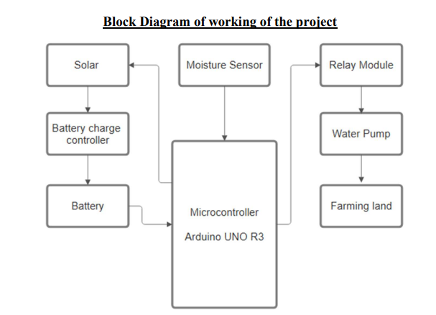
Proposed methodology
7

Slide 8
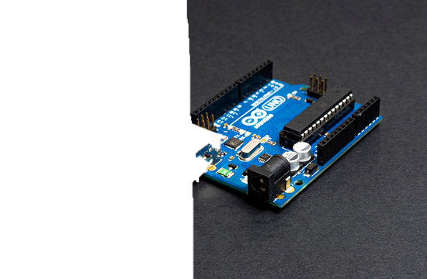
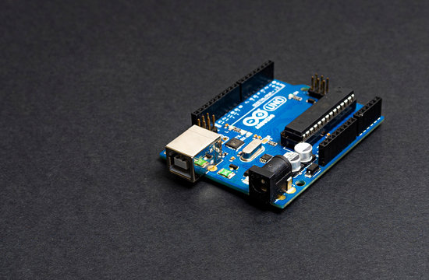

Components Used:
SL.NO | COMPONENT NAME | QUANTITY / TYPE
1 | 6v Solar panel | 3 units
2 | Servo Motor | 2
3 | LDR sensor | 4
4 | Moisture Sensors | 1
5 | Water pump | 1
6 | Battery pack with 2s BMS | 3.9v Li-ion*4
7 | Booster converter | 1
Arduino
uno
8 | Water sealing material (M seal) | 1
9 | Arduino UNO | 1
10 | Connecting wires | 1.5m, 3
11 | Sun board | 12x16(2 pcs)
12 | Water pump pipe | 1 m.
8

Slide 9
Arduino
uno

Slide 10
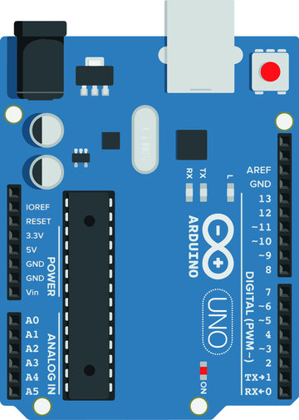
Servo 1
Servo 2
Tracking servo
Ldr 1(front)
Ldr 2(back)
Ldr open/close
10

Slide 11
1ST ARDUINO
Servo 1
Servo 2
Tracking Servo
Ldr 1(front)
Ldr 2(back)
Ldr open/close
11

Slide 12
2ND ARDUINO
Relay pin
Moisture Pin
Connected to submersible pump
12

Slide 13
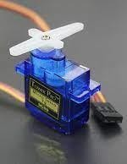
SERVO MOTOR
Operating Voltage is +5V typically
Torque: 2.5kg/cm
Operating speed is 0.1s/60°
Gear Type: Plastic
Rotation : 0°-180°
Weight of motor : 9gm
8/9/2024
13

Slide 14
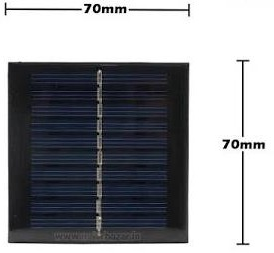
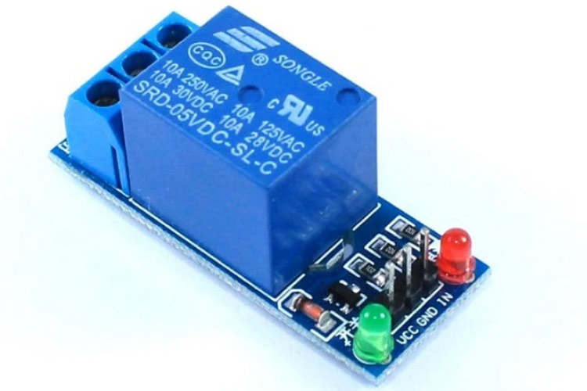
RELAY
SOLAR PANEL
Supply voltage – 3.75V to 6V
Quiescent current: 2mA
Current when the relay is active: ~70mA
Relay maximum contact voltage – 250VAC or 30VDC
Relay maximum current – 10A
Peak Power (Pmax): 4.5W
Voltage at Pmax (Vmp): 18V
Current at Pmax (Imp): 250mA
8/9/2024
14

Slide 15
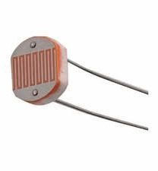
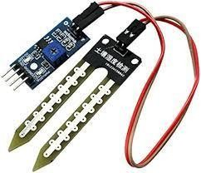
LDR SENSOR
MOISTURE SENSOR
Operating Voltage: 3.3V to 5V
Current Consumption: 15mA (typically)
Output Signal: Analog (0V to 4.2V)
Moisture Detection Range: 0% to 100%
Response Time: < 1s
Operating Voltage:3.3V to 5V
Resistance in Darkness:1MΩ (typically)
Resistance in Bright Light:5kΩ to 10kΩ (typically)
Spectral Peak: 540 nm (green region of the light spectrum)
Response Time: Rise time: 20ms, Fall time: 30ms
Power Dissipation: 100mW (maximum)
8/9/2024
15

Slide 16
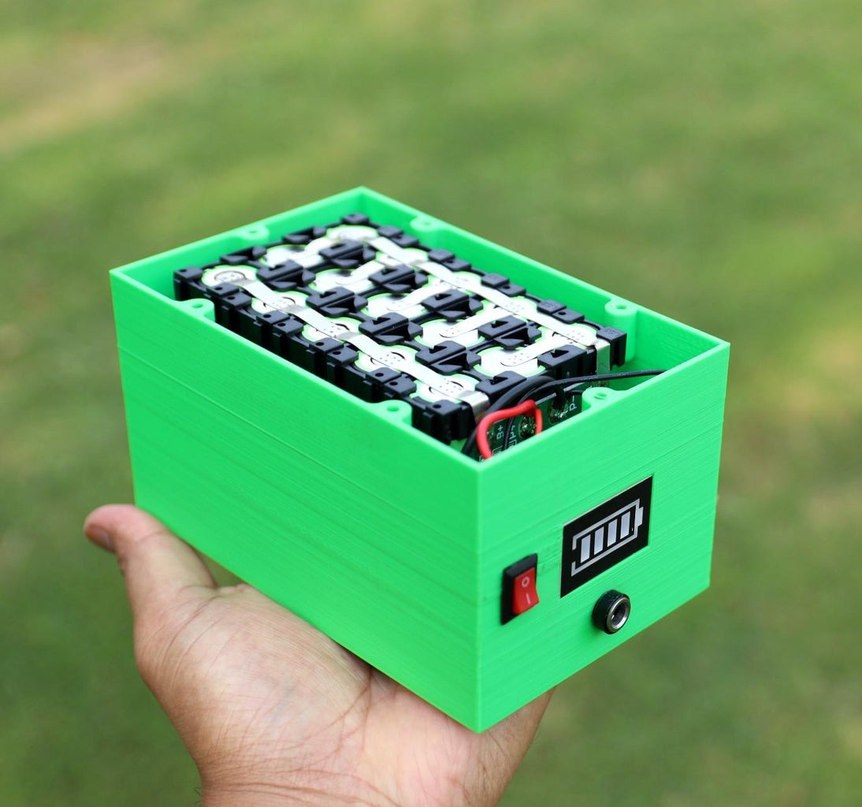
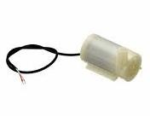
WATER PUMP
BATTERY PACK
Operating Voltage: 6V to 12V DC
Current Consumption: 200mA to 500mA
Flow Rate: 80 L/h to 240 L/h (liters per hour)
Maximum Lift: 1.5m to 3m (depends on model)
Power Consumption: 2W to 5W
Pump Type: Submersible or inline
Battery Type: Lithium-ion or Lithium-polymer
Nominal Voltage: 3.7V (single cell) or 7.4V (two cells in series)
Capacity: 1000mAh to 5000mAh (varies by pack size)
Charging Voltage: 4.2V (single cell) or 8.4V
Charging Current 0.5C to 1C
Discharge Current: Up to 2C
8/9/2024
16

Slide 17
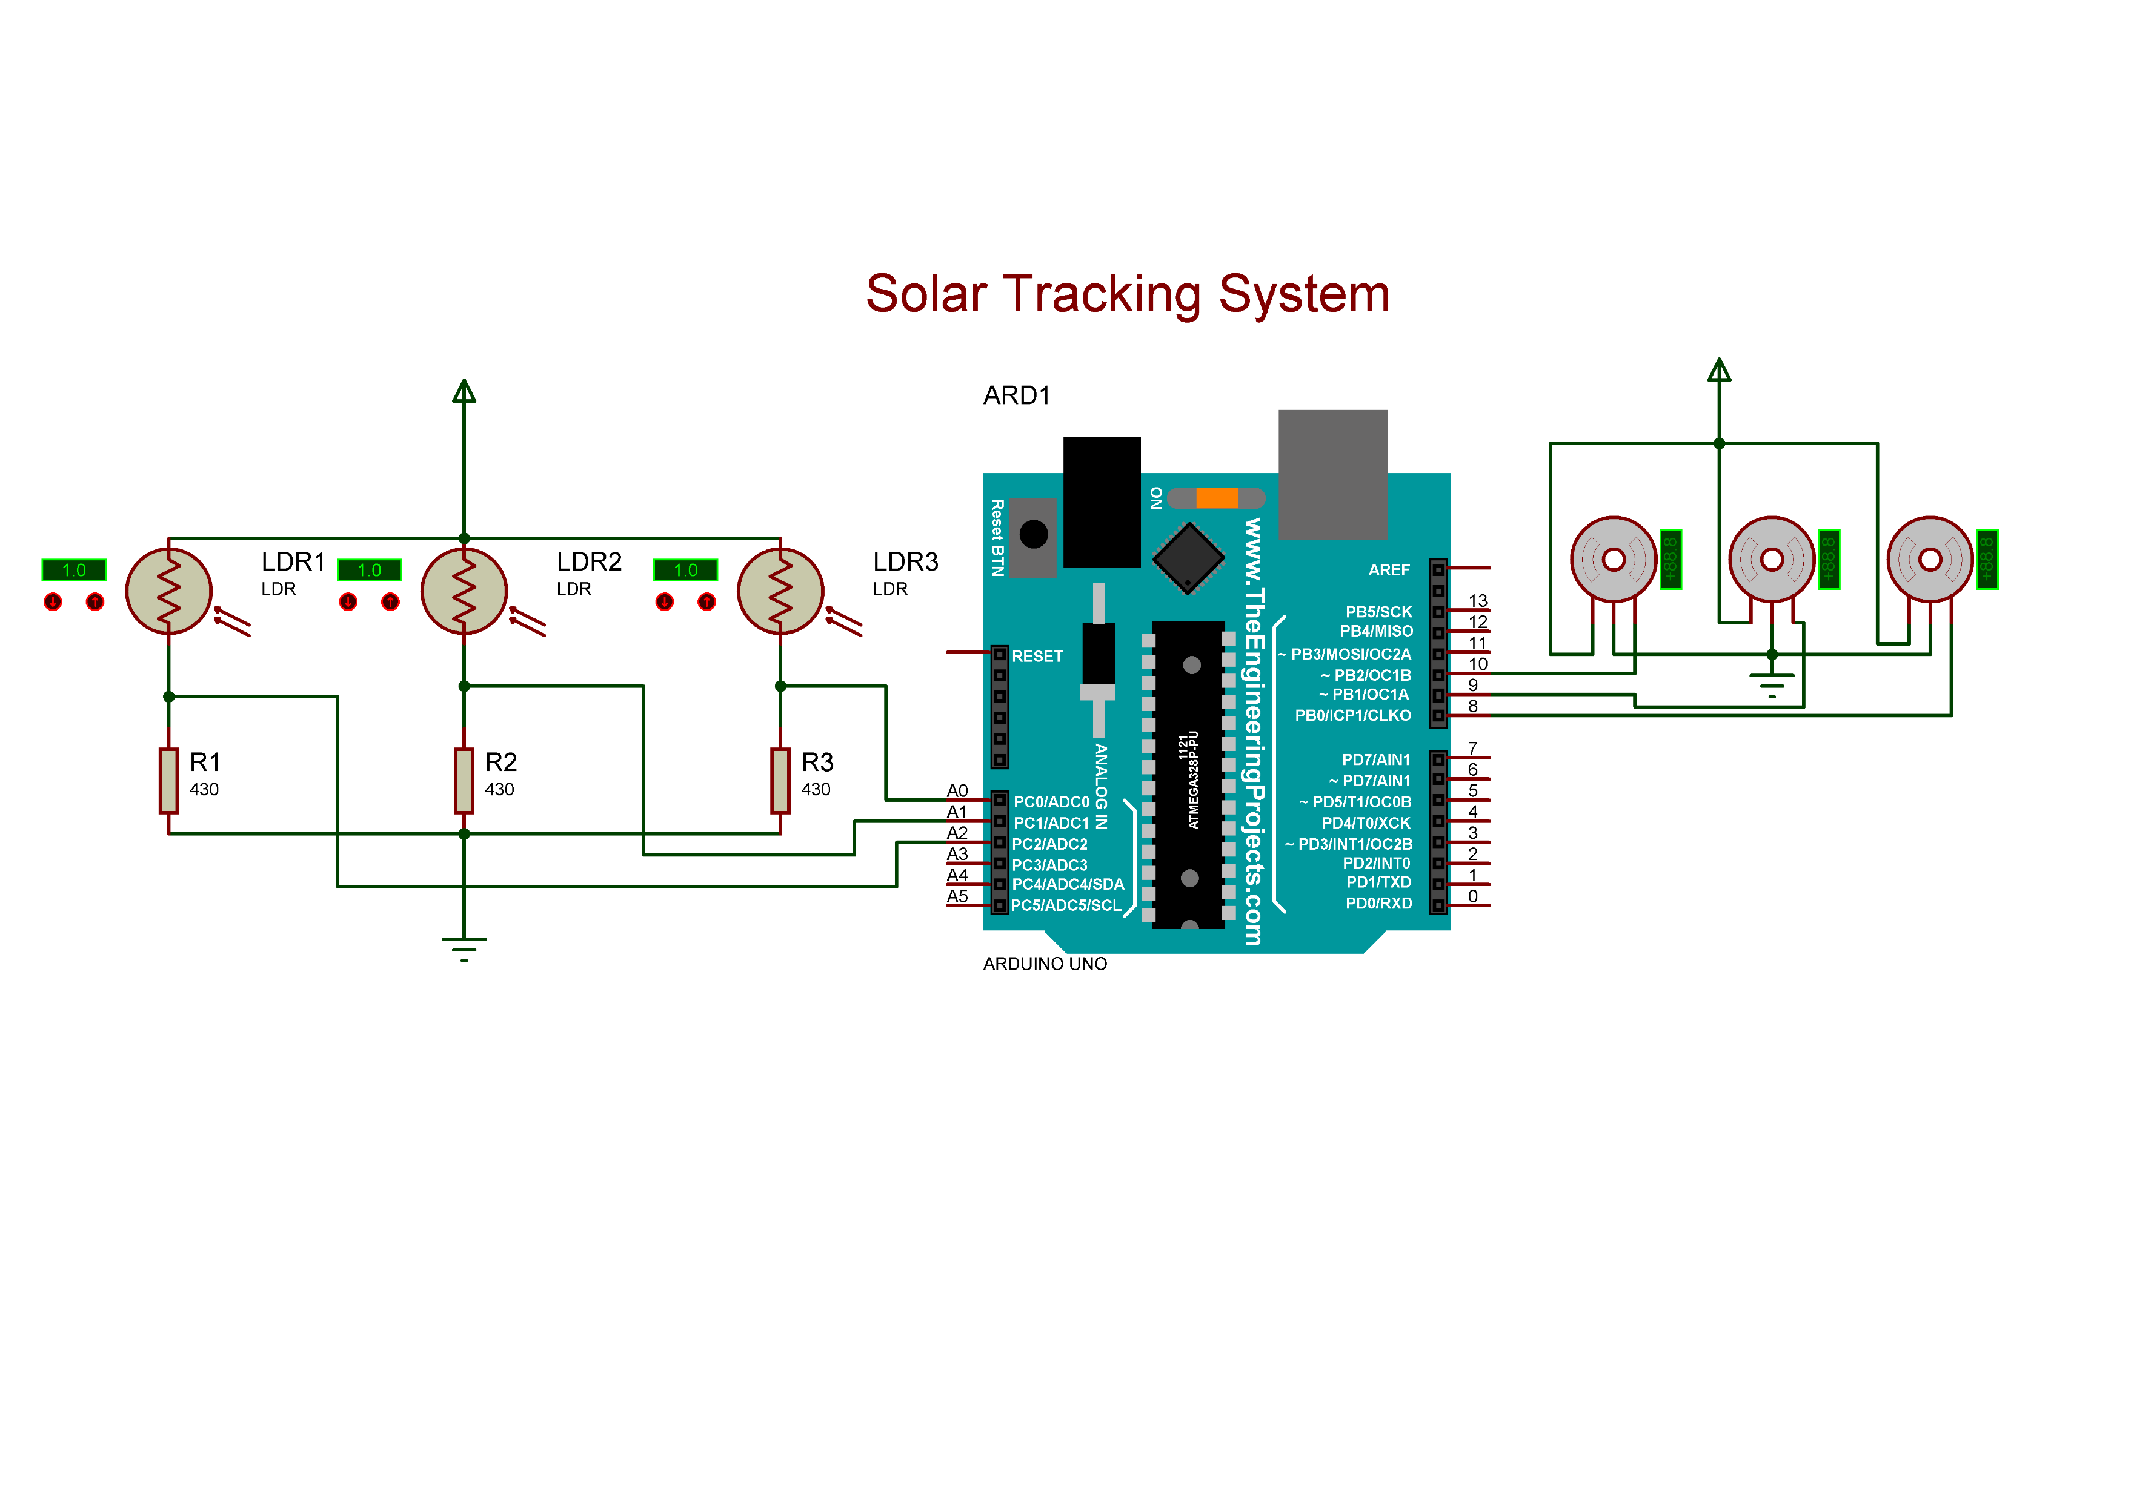
CIRCUIT DIAGRAM
17

Slide 18

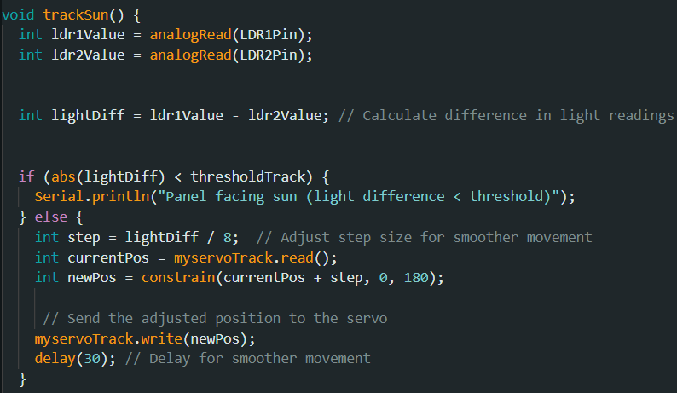
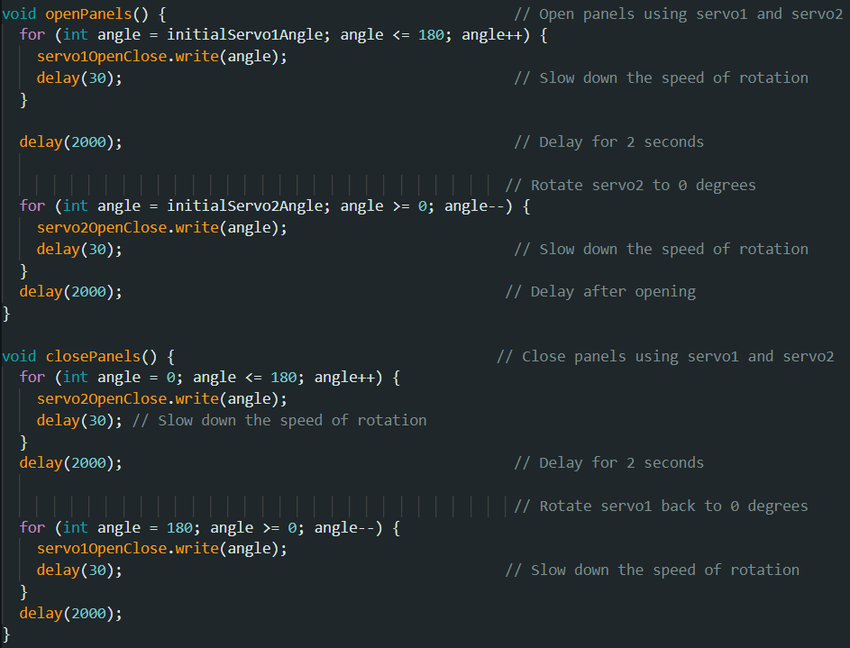
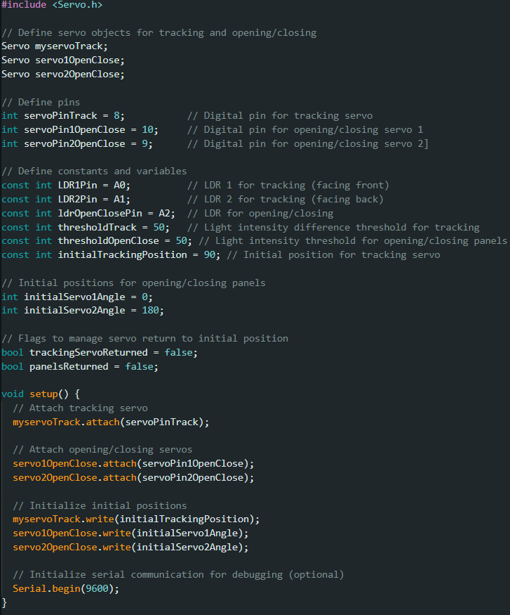
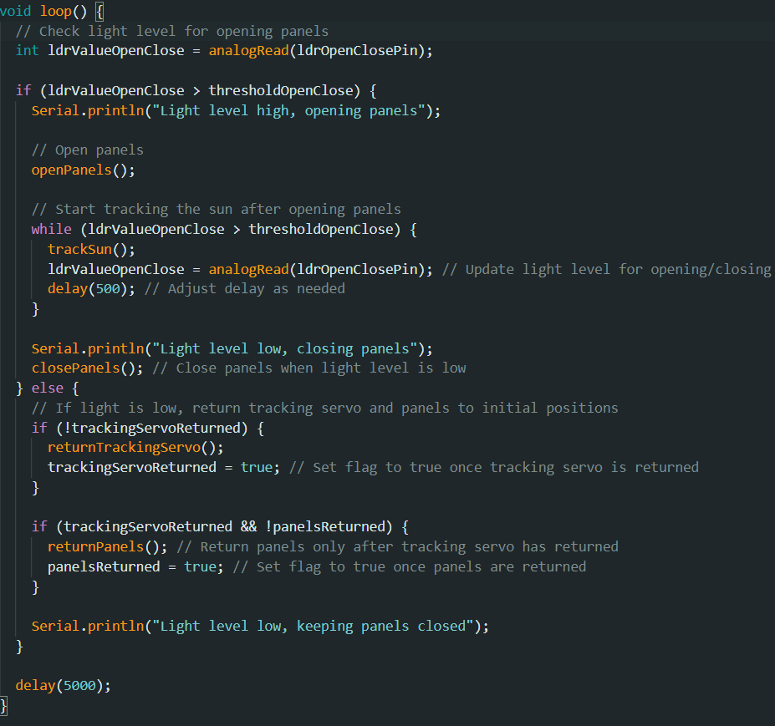
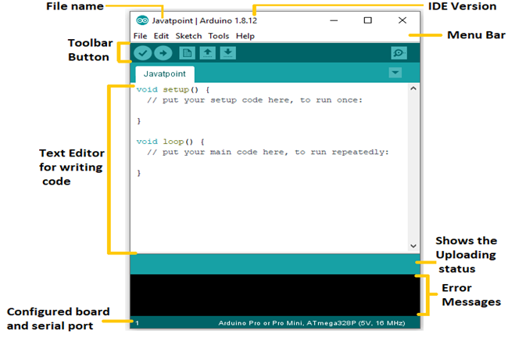
SOFTWARE USED:
INITIALIZATION
LOOP
TRACKING
OPENING/CLOSING
ARDUINO IDE
18

Slide 19
INITIALIZATION
LOOP
TRACKING
OPENING/CLOSING

Slide 20
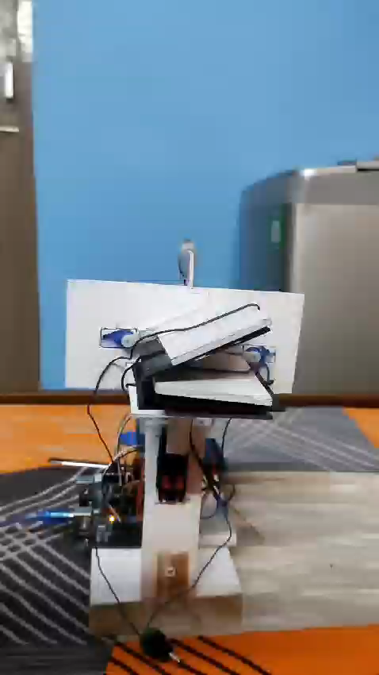
working
Solar Energy Harvesting: Solar panels, mounted on a solar tracker, follow the sun’s path to maximize sunlight capture. This harvested solar energy is converted into electrical power using photovoltaic technology.
Powering the Irrigation System: The electrical power generated by the solar panels drives a water pump, which is responsible for drawing water from wells or other sources.
Automated Irrigation Control: Soil moisture sensors continuously monitor soil conditions. When moisture levels fall below a set threshold, the sensors signal the pump to activate, ensuring targeted and efficient irrigation.
Adaptive Water Management: The system adjusts irrigation schedules based on real-time solar intensity and weather conditions. This adaptability optimizes water usage, enhances crop health, and improves agricultural productivity while reducing reliance on conventional energy sources.
20

Slide 21
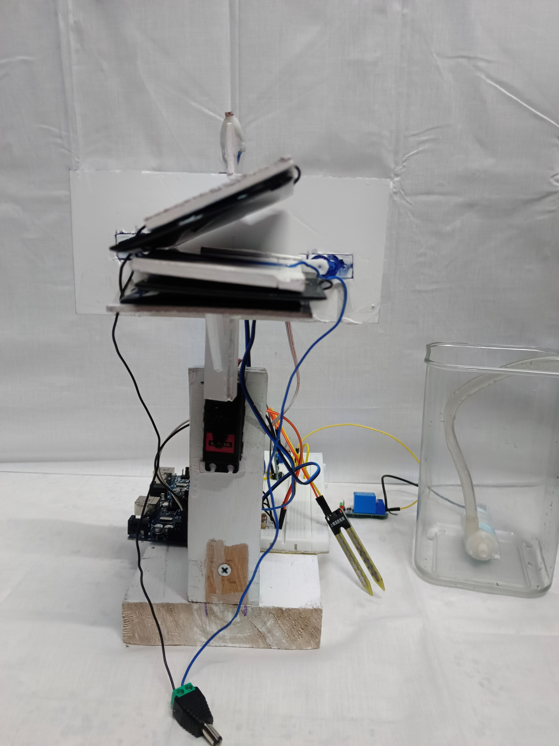
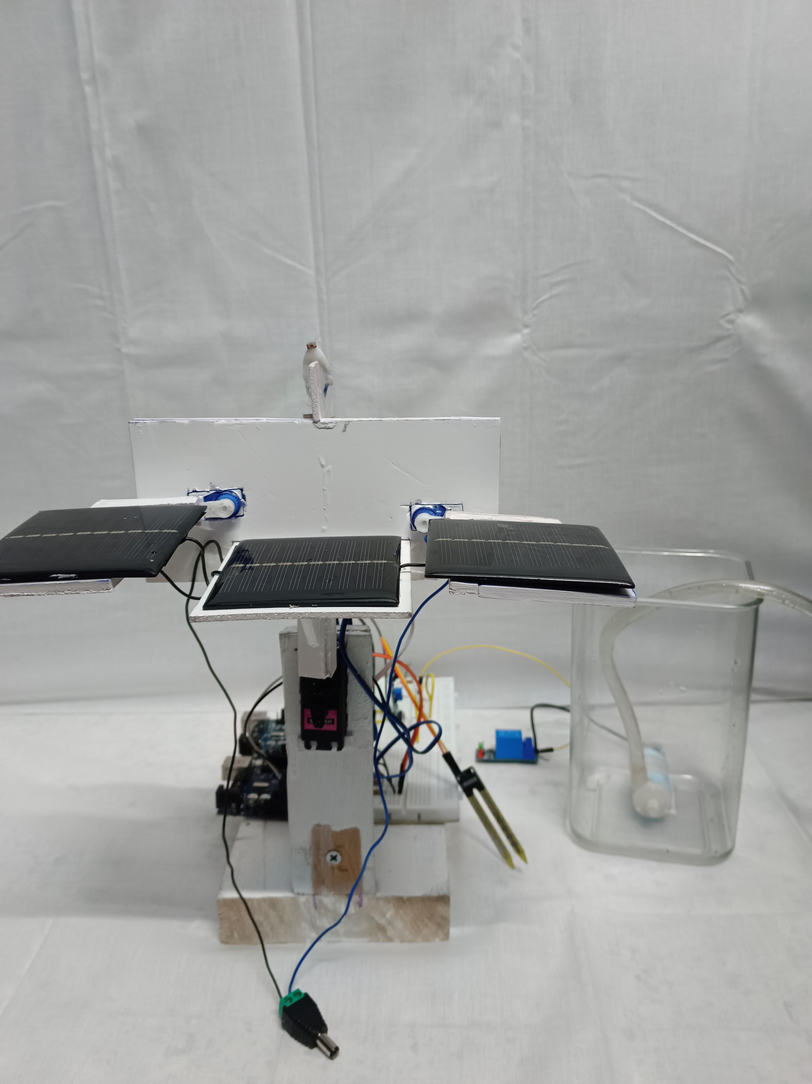
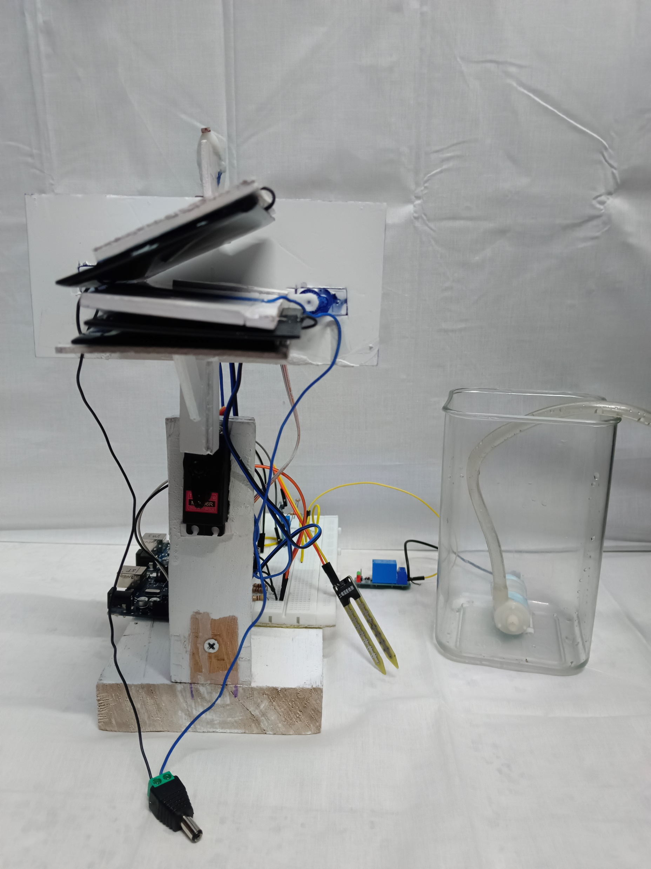
Photo of the project
INITIAL POSITION
OPEN POSITION
FINAL POSITION
21

Slide 22
ADVANTAGES
Enhanced Efficiency and Sustainability
Integration with Smart Agriculture
Adaptability to Climate Variability
Energy Independence and Cost Savings
Data-Driven Decision Making
Scalability and Accessibility
Research and Innovation
22

Slide 23
CONCLUSION
In conclusion, automatic irrigation systems enhanced by solar tracking technology represent a transformative approach to modern agriculture, offering a blend of efficiency, sustainability, and technological innovation Solar tracking optimizes irrigation schedules based on real-time solar data, ensuring precise water distribution to crops. This efficiency maximizes water usage effectiveness, enhancing crop health and yield potential while minimizing water wastage. By harnessing renewable solar energy, these systems reduce reliance on conventional energy sources. This not only lowers operational costs but also decreases carbon emissions and environmental impact, aligning with sustainable agricultural practices. Over time, the initial investment in solar tracking technology proves cost-effective through reduced energy bills and maintenance costs. Farmers benefit from long-term savings while improving the economic viability of their operations. Automatic irrigation systems with solar tracking can be tailored to fit diverse agricultural environments, from small-scale farms to extensive plantations. The flexibility to adjust irrigation patterns based on local conditions ensures optimal crop management and resilience against climate variability . The continuous evolution of solar tracking technology holds promising prospects for agriculture. Advances in sensors, data analytics, and automation will further enhance system efficiency and reliability, driving broader adoption and integration into global farming practices.
23

Slide 24
FUTURE SCOPE
Integration with Advanced IoT Platforms: Enhancing the system by integrating it with advanced IoT platforms for real-time data analytics, remote monitoring, and predictive maintenance, allowing for even more precise and efficient irrigation practices.
Scalability for Large-Scale Agriculture: Expanding the system to support large-scale agricultural operations, with the potential for networked solar tracking irrigation systems across multiple fields, coordinated through central control units.
Incorporation of AI and Machine Learning: Utilizing AI and machine learning algorithms to analyze historical data, optimize irrigation schedules, predict weather patterns, and improve decision-making processes, leading to smarter and more adaptive irrigation systems.
Development of Autonomous Farming Systems: Integrating the solar-powered irrigation system with other autonomous farming technologies, such as robotic harvesters and drones, to create a fully automated and sustainable farming ecosystem.
Enhanced Energy Storage Solutions: Exploring the use of advanced energy storage solutions, such as next-generation batteries or supercapacitors, to store excess solar energy, ensuring continuous operation even during cloudy days or nighttime.
Application in Diverse Agricultural Environments: Adapting the system for use in different agricultural environments, such as arid regions or urban farming setups, making it versatile and applicable in various climates and conditions.
Collaboration with Renewable Energy Initiatives: Partnering with renewable energy initiatives to promote the widespread adoption of solar-powered irrigation systems, contributing to global efforts in sustainable agriculture and reducing the carbon footprint of farming practices.
24

Slide 25
REFERENCES
1. Solar Powered Automatic Irrigation System Using Soil Moisture Sensor
Authors: Amrutha G E1, Sujay I J2, Sneha B3, Raghavendra D4, Karishma
[https://drive.google.com/file/d/1UEZc1UBRdBum887_Qpk0_qa4q_mpt6_N/view?usp=drivesdk](https://drive.google.com/file/d/1UEZc1UBRdBum887_Qpk0_qa4q_mpt6_N/view?usp=drivesdk)
2. Solar Tracking System
Author: Nur Khuzairy Bin Jamaludin (2008)
[https://drive.google.com/file/d/1UEBzqZlZGbyKoPPjY_XXhK5TDnel8OE0/view?usp=drivesdk](https://drive.google.com/file/d/1UEBzqZlZGbyKoPPjY_XXhK5TDnel8OE0/view?usp=drivesdk)
3. Solar Tracking System - A Review
Authors*: Suneetha Rachara and K Rajan
[https://drive.google.com/file/d/1UEBzqZlZGbyKoPPjY_XXhK5TDnel8OE0/view?usp=drivesdk](https://drive.google.com/file/d/1UEBzqZlZGbyKoPPjY_XXhK5TDnel8OE0/view?usp=drivesdk)
4. Automatic Irrigation System Using Solar Tracking Device
Author: C.V. Suresh Babu
[https://scholar.google.com/scholar?hl=en&as_sdt=0%2C5&q=automatic+irrigation+using+solar+tracking&btnG=#d=gs_qabs&t=1721040892588&u=%23p%3D2oMEsLVj9M4J](https://scholar.google.com/scholar?hl=en&as_sdt=0%2C5&q=automatic+irrigation+using+solar+tracking&btnG=#d=gs_qabs&t=1721040892588&u=%23p%3D2oMEsLVj9M4J)
25

Slide 26

26

